Slide 1
COMMUNICATION
BEING A SEMINAR PRESENTED BY
OBOT, BRIAN DAVID EE/17/328 AKAN, KINGLSEY ITAH
EE/17/228 IDOLOR, KESTER EE/17/297 DEPARTMENT OF ELECTRICAL ELECTRONICS ENGINEERING MADONNA UNIVERSITY, AKPUGO CAMPUS FACULTY OF ENGINEERING AND TECHNOLOGY
PRESENTED TO THE DEPARTMENT OF ELETRICAL ELECTRONICS ENGINEERING
MAY, 2022

Slide 2
1.0 MOTIVATION FOR THE WORK To display an in-depth understanding on the application and operation of Radio Frequency Circuitry in the field of Electronics and Communication Engineering.
Less obviously is the need to create a foundation upon which higher and more technical research and studies can and would be carried out in Engineering field in Madonna University, Akpugo Campus

Slide 3
2.0 PROBLEM STATEMENT Radio Technology and its application in research and development has been a highlight in last century of human development. And Nigeria has a country has unfortunately not been at or close to the frontline of this exciting field. This project is designed to not only provide a path to incentivize more research and development in the field, but also to provide a working instrument to be used for research within and outside the institution environment for any person that are in the vicinity.

Slide 4
3.0 AIM/OBJECTIVE OF THE STUDY The main aim of this work is to study and thereafter successfully design and construct a long range Radar system within the school vicinity.
At the end of this work the following objectives shall be achieved:
i. The production of a comprehensive documentation, detailing the design process and instruction guiding the operation of the radar system to be constructed, this would be done to aid further research and development into this project by future generation.
ii.A working Model of a Radar system within the school vicinity

Slide 5
5.0 SCOPE, LIMITATION AND SIGNIFICANCE
The scope of this paper is to provide a comprehensive study of designing and eventually constructing a Radar system for use at Madonna University, Akpugo Campus.
LIMITATIONS
i. Difficulty to access to materials needed to for the system
ii. The cost of construction and materials are high
SIGNIFICANCE
To provide a functional Radar system upon which further research and development can and would be carried out within the school academia.

Slide 6
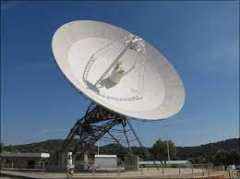
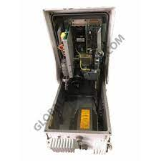
6.0 MATERIALS AND METHOD
MATERIALS
Antenna (Parabolic Antenna),
RF Transmitter,

Slide 7
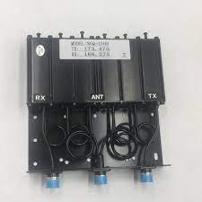
RF Receiver
Duplexer
RF Oscillator,
Modulator
Coaxial Cables
Metal Frames
other Smaller electronics components like Diode, Resistors etc

Slide 8
METHOD
Step 1: Design a details paper version of the system
Step 2: Import and buy prefabricated materials where necessary
Step 3: Prepare subsystem circuitry to specification
Step 4: Assemble the different components together according
Step 5: Write a program to be used to digital Radar input (Reflected Radio Waves)
Step 6: Repeat the step 4 and 5 until the material exhaust. Once the material is exhausted, then fill with the old sand which you removed from the pit.
Step 7: Test and repeat step 4 through 7 if necessary
Step 8: Commission the completed project

Slide 9
CONCLUSION
Radar is a crucial part of many modern infrastructures and operations. The design has to be both durable and reliable. There are many steps to design a reliable and accurate radar system. Hand calculations may be a tedious and difficult. Doing calculations and modifications to the design can be a long process. The main intention of Radar System is to keep aid the process of range detection and monitoring of targets. And finally the fabrication or assembly process of the whole system must be carried out carefully and with materials that are durable for the system effective operation.

Slide 10
REFERENCE
https://studiousguy.com/working-principle-radar/
https://en.wikipedia.org/wiki/History_of_radar
https://link.springer.com/content/pdf/bfm%3A978-1-4613-1971-9%2F3%2F1.pdf
https://www.researchgate.net
https://www.tutorialspoint.com/radar_systems/radar_systems_pulse_radar.html
https://www.radartutorial.eu/01.basics/rb67.en.html
https://www.toppr.com/ask/question/explain-the-principle-and-working-of-radar-with-neat-block-diagram/
https://nanopdf.com/download/23-radar-block-diagram-and-operation_pdf
Radar System Design (final version) project by
Lamis Islam Ahmed-zaki
Marwa Mostafa Hedayah
Mostafa Mohsen Mostafa Kamal
Shady Mohamed Mahmoud
https://electronicsdesk.com/radar-system.html
https://www.davuniversity.org/images/files/studymaterial/Radar%20System%20_notes.pdf

